Slide 1


Architectural Innovations in Quantum and Optical Computing
by
Tasdiqul Huq
ID-0692220005101006
Batch-19

Slide 2
Introduction
The Quantum Leap
*Quantum computing leverages the principles of quantum mechanics to perform computations.
*Qubits, the quantum equivalents of bits, can exist in multiple states simultaneously, enabling exponential speedups.
The Photonic Future
*Optical computing harnesses the power of light to process information.
*Photons, the particles of light, can transmit data at the speed of light, promising faster and more efficient computing.

Slide 3
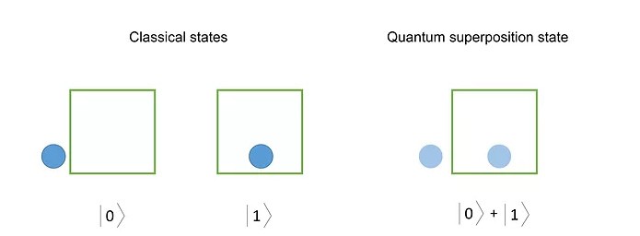
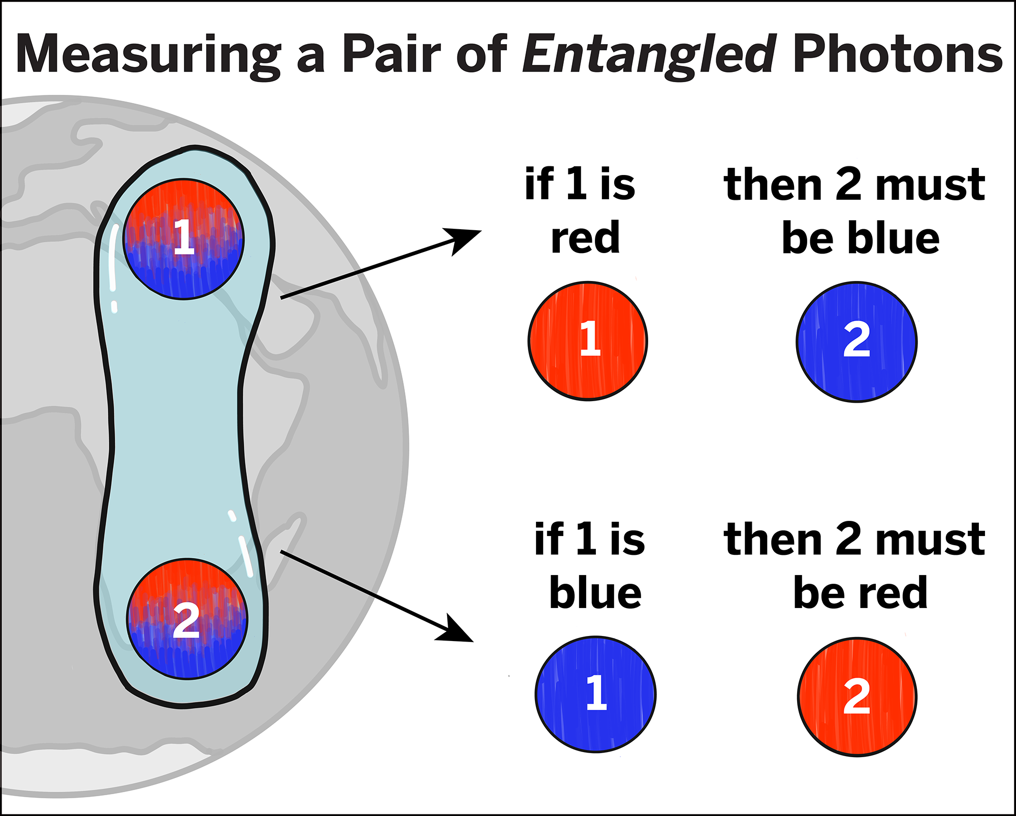
What is Quantum Computing?
Quantum computing is a field that uses quantum mechanics to solve complex problems faster than classical computers. It uses quantum bits, or qubits, to process information, and takes advantage of quantum mechanical effects like superposition and entanglement.

Slide 4
Types of Qubit Architectures
*Superconducting Qubits
*Trapped-Ion Qubits
*Photonic Qubits
*Spin Qubits

Slide 5
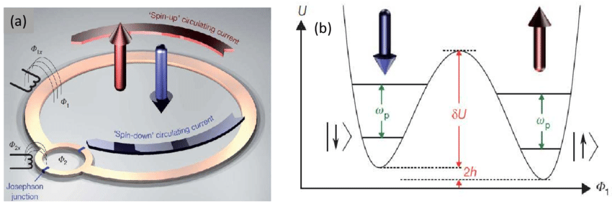
Superconducting Qubits
*Utilize superconducting circuits to manipulate qubits.
*Currently the most advanced and widely used qubit technology.

Slide 6
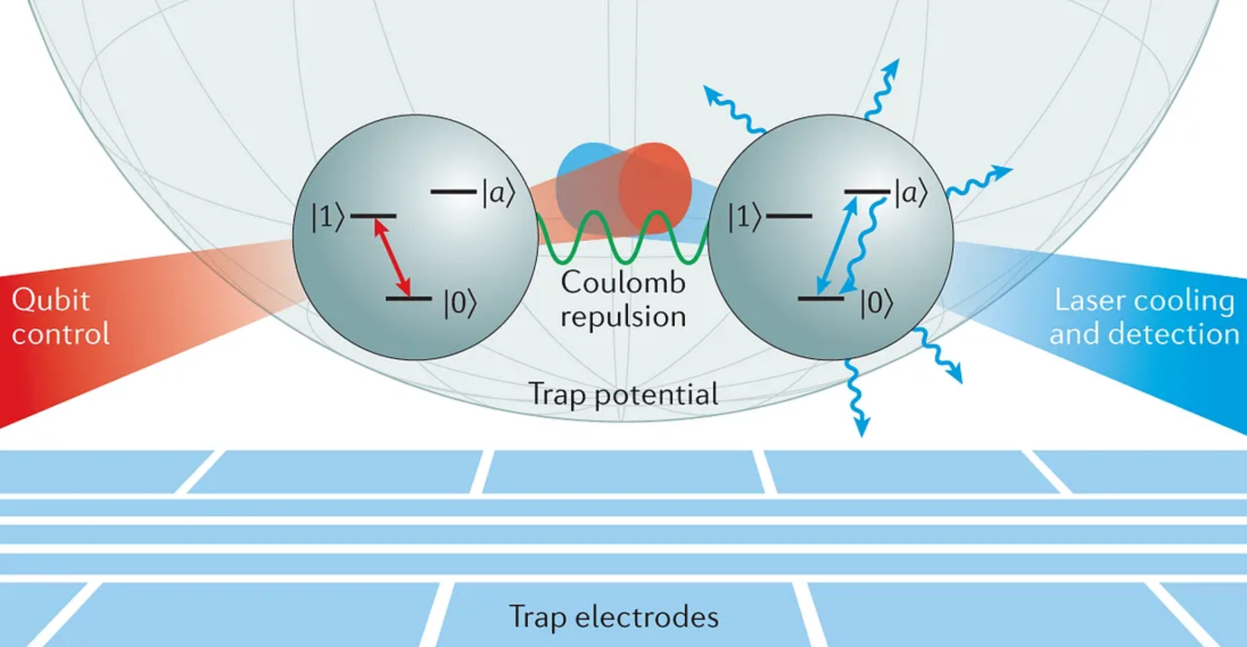
Trapped-Ion Qubits
*Employ lasers to control individual ions trapped in electromagnetic fields.
*Offer long coherence times and high-fidelity operations.

Slide 7
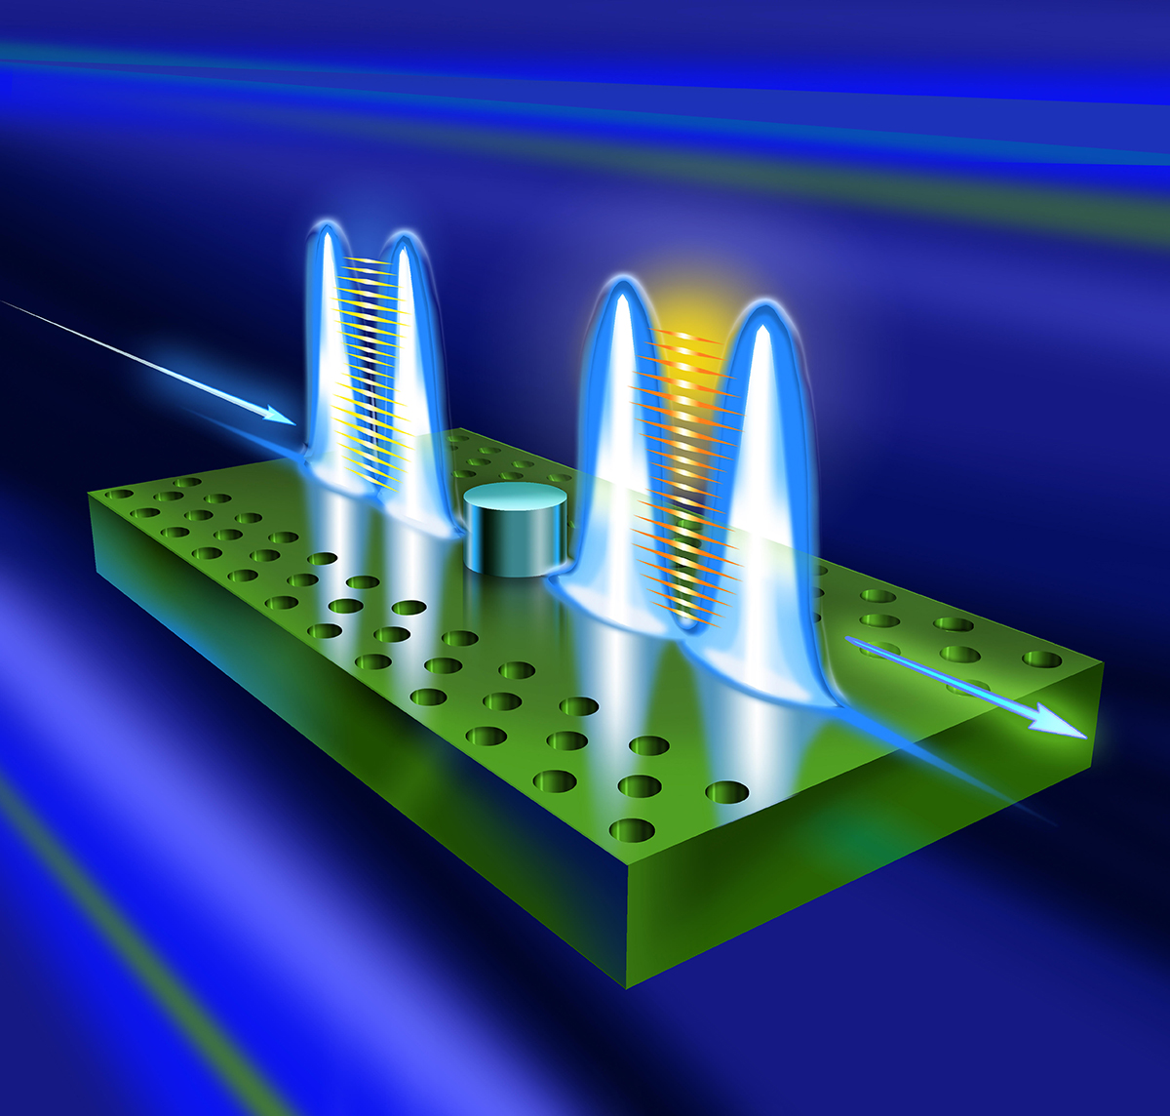
Photonic Qubits
*Utilize photons as qubits, offering potential advantages in scalability and error connection.
*Quantum information can be encoded in multiple ways, including in the polarization of the photons (horizontal or vertical) or in their paths of travel (path encoding).

Slide 8
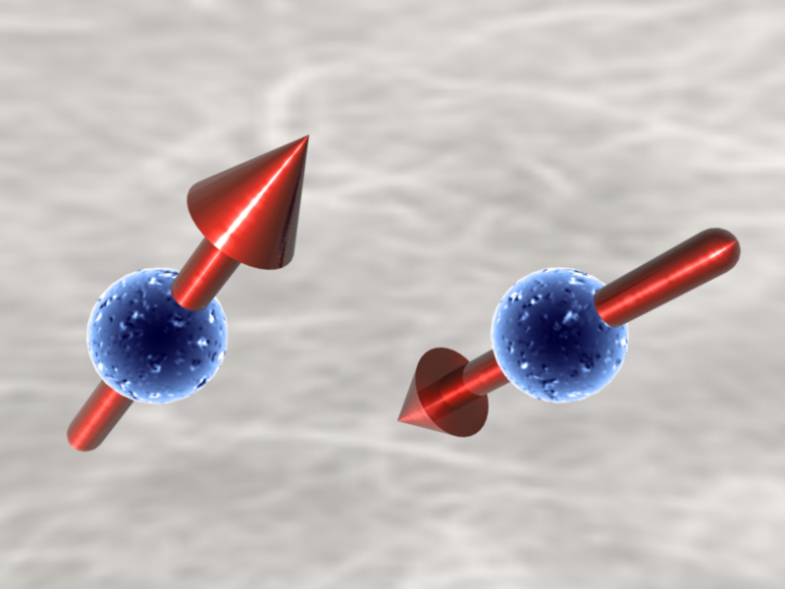
Spin Qubits
*Exploit the spin states of electrons nuclei as qubits.
*Promising for quantum sensing and quantum simulation.

Slide 9
Quantum Error Correction
*Quantum Error Correction Codes:
-Detect and correct errors that occur during quantum computations.
-Essential for reliable quantum computing.
*Topological Quantum Computing
-A promising approach that uses topological properties of matter to create robust qubits.
-Offers potential for fault-tolerant quantum computation.

Slide 10
Quantum Algorithms
*Shor’s Algorithm:
-Efficiently factors large numbers, posing a threat to current cryptographic systems.
*Grover’s Algorithm:
-Searches unstructured databases more efficiently than classical algorithms.

Slide 11
What is Optical Computing?
Optical computing is a form of computing where light (typically photons) is used to represent and manipulate data, rather than electricity (which uses electrons) as in traditional electronic computing. The fundamental idea is to leverage the unique properties of light—such as high speed, low energy dissipation, and the ability to process information in parallel—to achieve faster and more efficient computations.

Slide 12
Types of Optical Computing Architectures
*Optical Fourier Processors
*Optical Neural Networks
*Optical Digital Computers
*All-Optical Signal Processing
*Photonic Quantum Computing

Slide 13
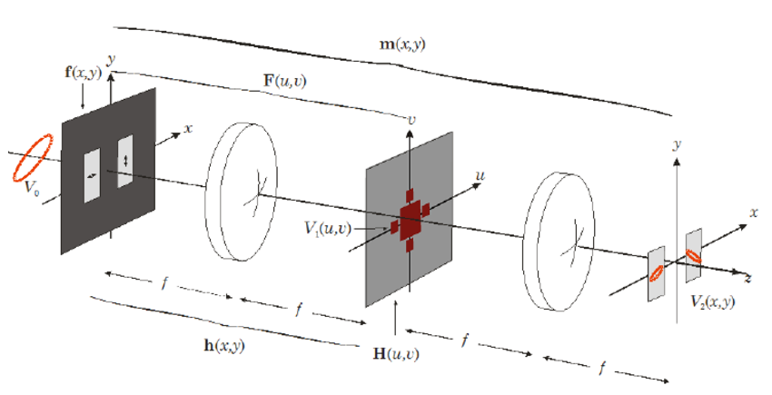
Optical Fourier Processor
*Utilize the Fourier transform property of lenses to perform mathematical operations, such as image processing and pattern recognition.
*Can be used for tasks like medical image analysis and radar signal processing.

Slide 14
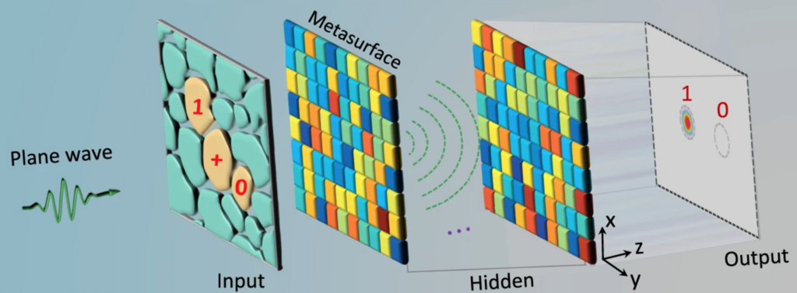
Optical Neural Networks
*Inspired by the human brain, these networks use light to process information.
*Have the potential to revolutionize artificial intelligence by enabling faster and more energy-efficient learning.

Slide 15
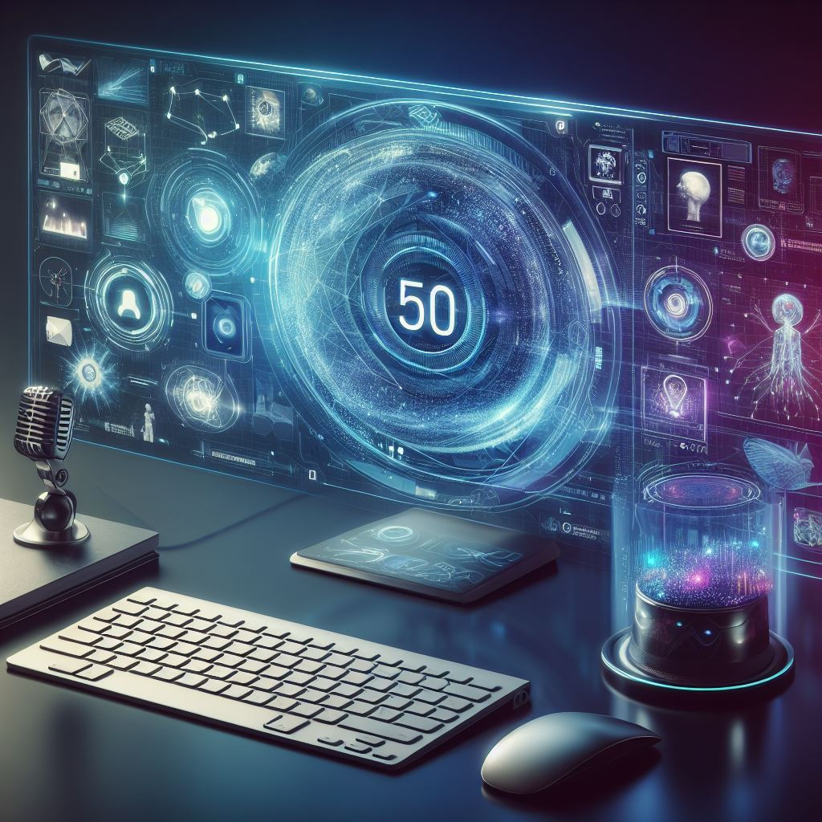
Optical Digital Computers
*Aim to replace electronic components with optical ones to achieve higher speeds and lower power consumption.
*Still in the early stages of development, but have the potential to significantly improve computing performance.

Slide 16
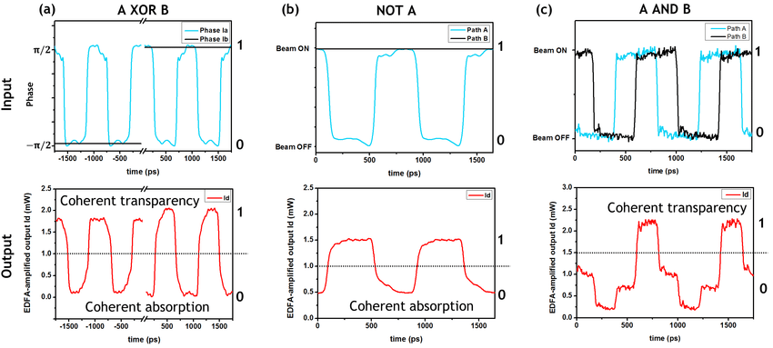
All-Optical Signal Processing
*Processes information directly in the optical domain, eliminating the need for conversion to electrical signals.
*Can be used for high-speed communication and data processing.

Slide 17
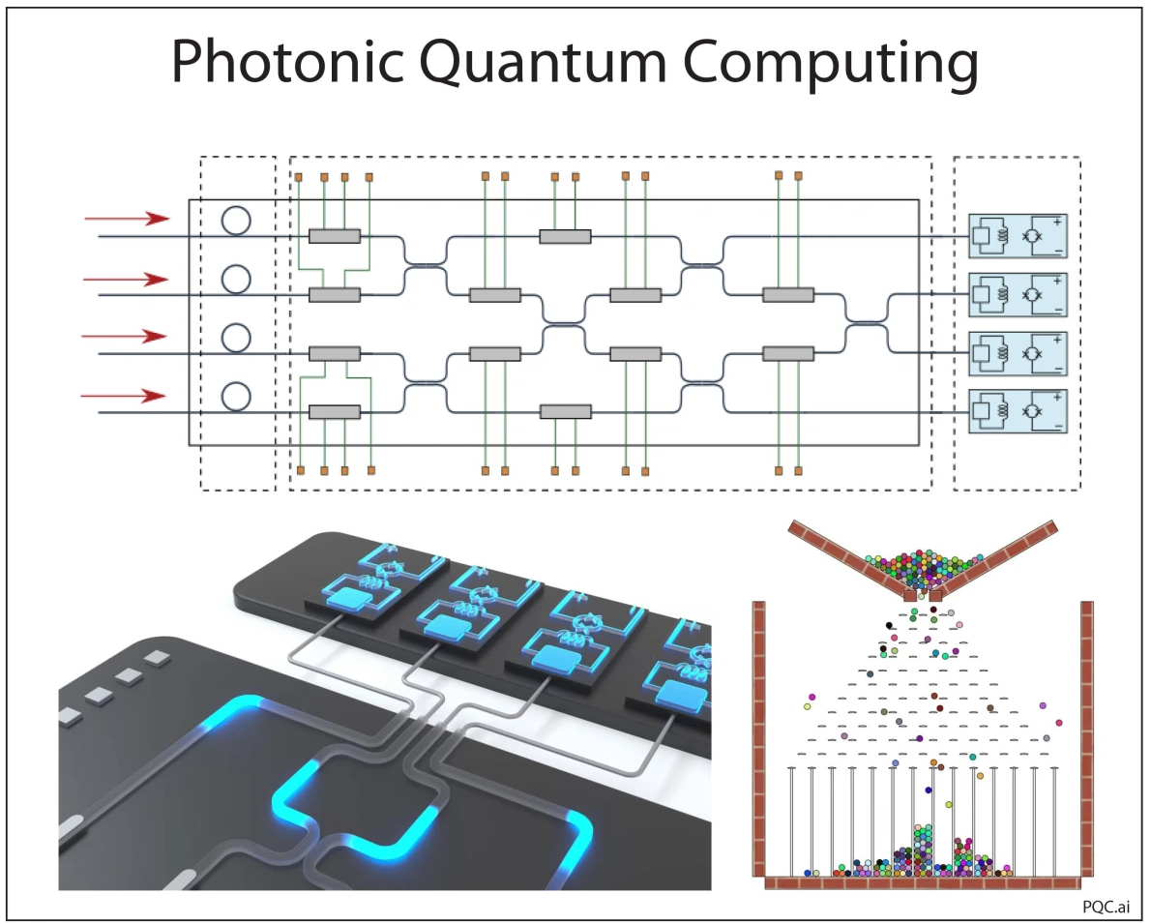
Photonic Quantum Computing
*Combines the principles of quantum mechanics and photonics to perform computations.
*Has the potential to solve complex problems that are intractable for classical computers.

Slide 18
Challenges and Future Directions
*Qubit Coherence: Maintaining the quantum state of qubits for long enough to perform complex calculations.
*Scalability: Building large-scale quantum and optical computers.
*Error Correction: Developing effective error correction techniques.

Slide 19
Conclusion
*Quantum and optical computing hold the potential to revolutionize various fields, including:
-Materials science
-Drug discovery
-Artificial intelligence
-Cryptography
*Continued research and development are crucial to overcome challenges and realize the full potential of these technologies.

Slide 20
References
https://research.ibm.com/quantum-computing/ [27/10/24]
https://quantum.microsoft.com/ [27/10/24]
https://quantumai.google/ [27/10/24]
https://www.nature.com/nphoton/ [27/10/24]
https://opg.optica.org/optica/ [27/10/24]

Slide 21
THANK YOU!

